Slide 1





SINCHANA A B
SPRING
SECURITY
IN SPRING BOOT

Slide 2
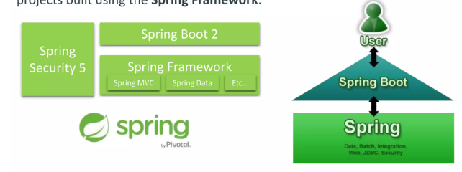
SINCHANA A B
SPRING FRAMEWORK VS. SPRING BOOT VS. SPRING SECURITY
Spring Framework is a Java platform that provides comprehensive infrastructu support for developing Java applications.
Spring Boot is based on the Spring Framework, providing auto-configuration features to your Spring applications and is designed to get you up and running as quickly as possible
Spring Security provides comprehensive security services for Java EE-based software applications. There is a particular emphasis on supporting projects built using the Spring Framework.

Slide 3
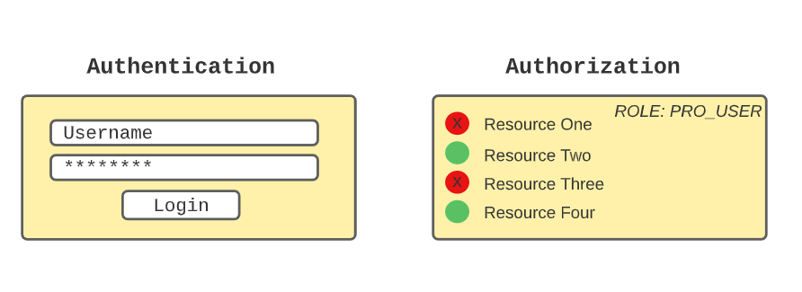
SINCHANA A B
WHAT IS SPRING SECURITY?
Spring Security is a framework that focuses on providing both authentication and authorization (or "access-control") to Java web application and SOAP/RESTful web services
Spring Security currently supports integration with all of the following technologies:
→HTTP basic access authentication
LDAP system
> OpenID identity providers
ESB Platform
Your own authentication systems
It is built on top of Spring Framework

Slide 4

SINCHANA A B
SPRING SECURITY FUNDAMENTALS
> Principal
› User that performs the action
6
> SecurityContextHolder
› Provides access to SecurityContext
1
2
Authentication
› Confirming truth of credentials
7
Authentication Manager
› Controller in the authentication prod
3
> Authorization
> Define access policy for principa
Authentication Provider
› Interface that maps to a data store which stores your user data.
8
4
> GrantedAuthority
› Application permission granted to a principal
9
Authentication Object
› Object is created upon authentication, which holds the login credentials.
> SecurityContext
› Hold the authentication and other security information
10
UserDetails
> Data object which contains the user credentials, but also the Roles of the user.
› UserDetailsService
› Collects the user credentials, authorities(roles) and build an UserDetails object.
5

Slide 5
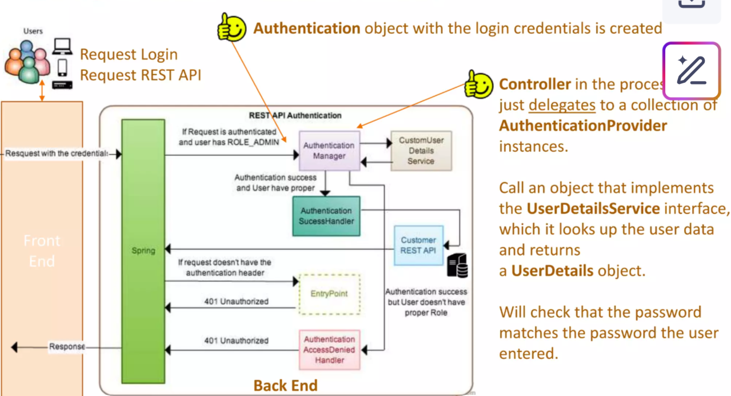
SINCHANA A B
SPRING SECURITY COMMON WORKFLOW

Slide 6

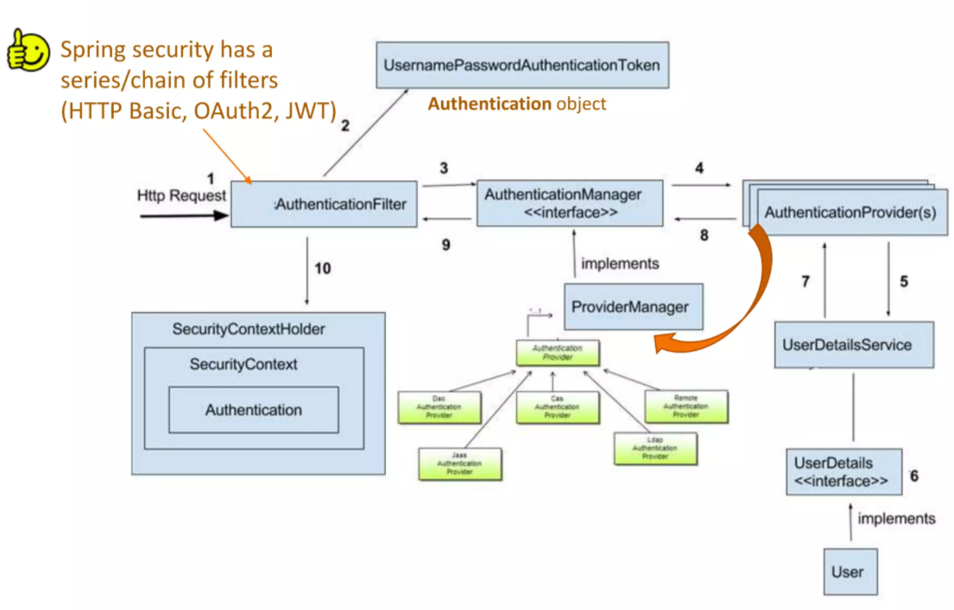
SINCHANA A B
SPRING SECURITY ARCHITECTURE

Slide 7

SINCHANA A B
SPRING SECURITY
THANK YOU

